Slide 1
Predicting Top 10 Songs in the billboard Hot 100

Slide 2

introduction
Motivation
Optimize investments in artists to maximize chart success
Objective
Analyze audio features of Billboard Hot 100 songs
Develop model to determine ideal song elements for a top 10 song

Slide 3
project scope
Primary metric - Recall
Labels invest in many artists, hoping to earn big profits on a select few
Estimate: Top 10 songs earn 8 times as much as songs outside of the top 10

Slide 4
methodology
Compile Billboard Hot 100 chart data.
Gather audio feature data for corresponding songs from Spotify API.
Perform feature engineering to identify important features.
Tune hyperparameters of best models.
Data Cleaning & EDA
Refining Promising Models
Baseline Models
Finalize & Test Model
Oversample and cross-validate data.
Try various classifiers for preliminary diagnosis.
Identify best model and test to determine performance.
Formulate recommendations.

Slide 5
data analysis
Prominent features
Valence
Artist Frequency
Energy
Decade
Danceability
Debut Position

Slide 6

Notes:
LiveSlide Site
https://public.tableau.com/profile/andrew.graves8383#!/vizhome/Tableau_project3_EDA/Dashboard1

Slide 7
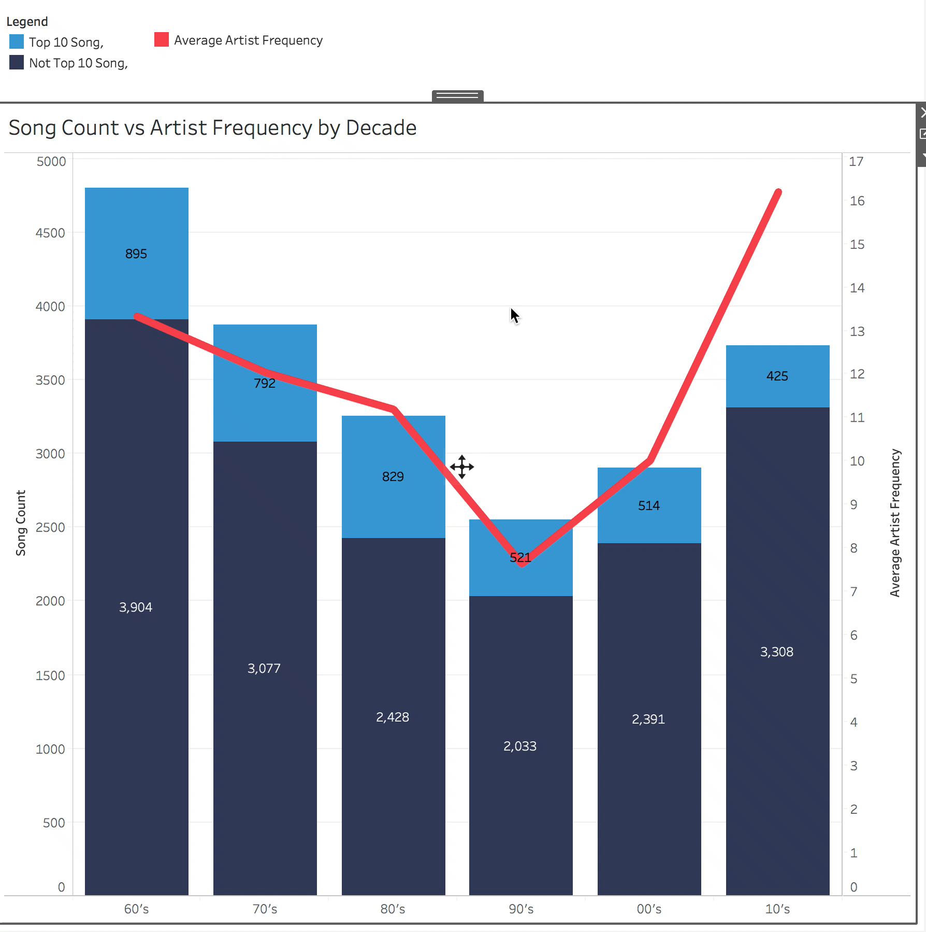
Notes:
Danceability has standard deviation of 0.15, so increasing danceability from 0.5 to 0.65 will give you 80% increased chance of getting a top 10 song.

Slide 8



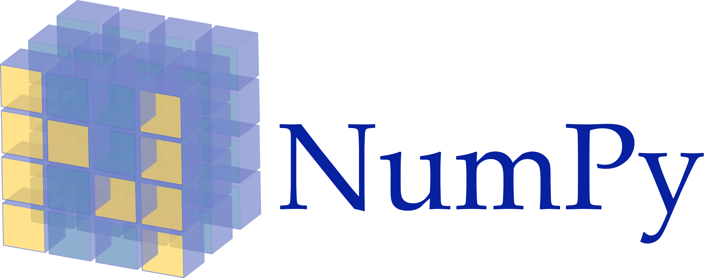


methodology
Classifier | Precision | Recall | F-beta Score
Neural Network (Linear) | 32.4 | 64.8 | 54.0
Logistic Regression | 32.4 | 64.8 | 54.0
LinearSVC | 32.1 | 64.8 | 53.8
Decision Tree | 32.4 | 62.8 | 52.9
Naïve Bayes | 23.5 | 70.4 | 50.3
XGBoost | 42.9 | 42.8 | 42.8
Random Forests | 46.0 | 33.4 | 35.3

Slide 9
methodology
Classifier | Precision | Recall | F-beta Score
Neural Network (Linear) | 32.4 | 64.8 | 54.0
Logistic Regression | 32.4 | 64.8 | 54.0
LinearSVC | 32.1 | 64.8 | 53.8
Decision Tree | 32.4 | 62.8 | 52.9
Naïve Bayes | 23.5 | 70.4 | 50.3
XGBoost | 42.9 | 42.8 | 42.8
Random Forests | 46.0 | 33.4 | 35.3

Slide 10
methodology
Compile Billboard Hot 100 chart data.
Gather audio feature data for corresponding songs from Spotify API.
Perform feature engineering to identify important features.
Tune hyperparameters of best models.
Data Cleaning & EDA
Refining Promising Models
Baseline Models
Finalize & Test Model
Oversample and cross-validate data.
Try various classifiers for preliminary diagnosis.
Identify best model and test to determine performance.
Formulate recommendations.

Slide 11
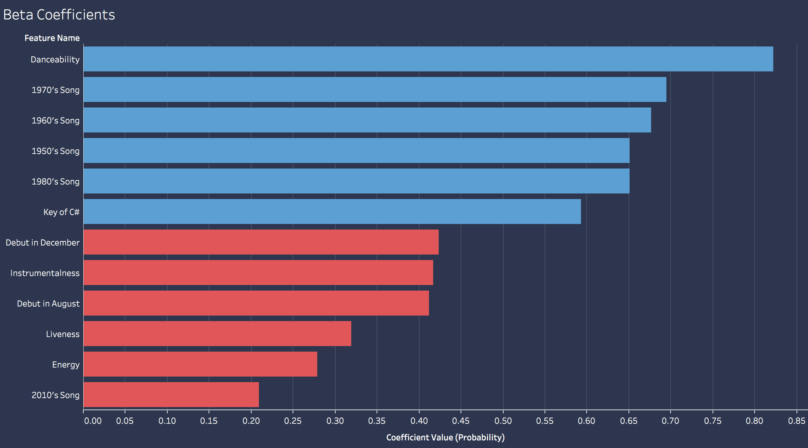
results

Slide 12
results
Danceability = Strongest feature

Slide 13
results
Danceability = Most predictive feature
1970’s song = 70% chance of top 10 hit
2010’s song = 20% chance of top 10 hit
Notes:
Danceability has standard deviation of 0.15, so increasing danceability from 0.5 to 0.65 will give you 80% increased chance of getting a top 10 song.

Slide 14
results
Logistic Regression Model optimized for best F-beta score (beta = 2)

Slide 15
results
Logistic Regression Model optimized for best F-beta score (beta = 2)
F-beta = 0.58

Slide 16
recommendations
F-beta = 0.58
High recall but poor precision
Invest twice as much in songs with potential, aim to get 8 times as much profit
Profit from top 10 songs outweighs loss from false predictions
31 | 50
3 | 16
Not
Top 10
Actual
Top 10
Not Top 10
Top 10
Predicted

Slide 17
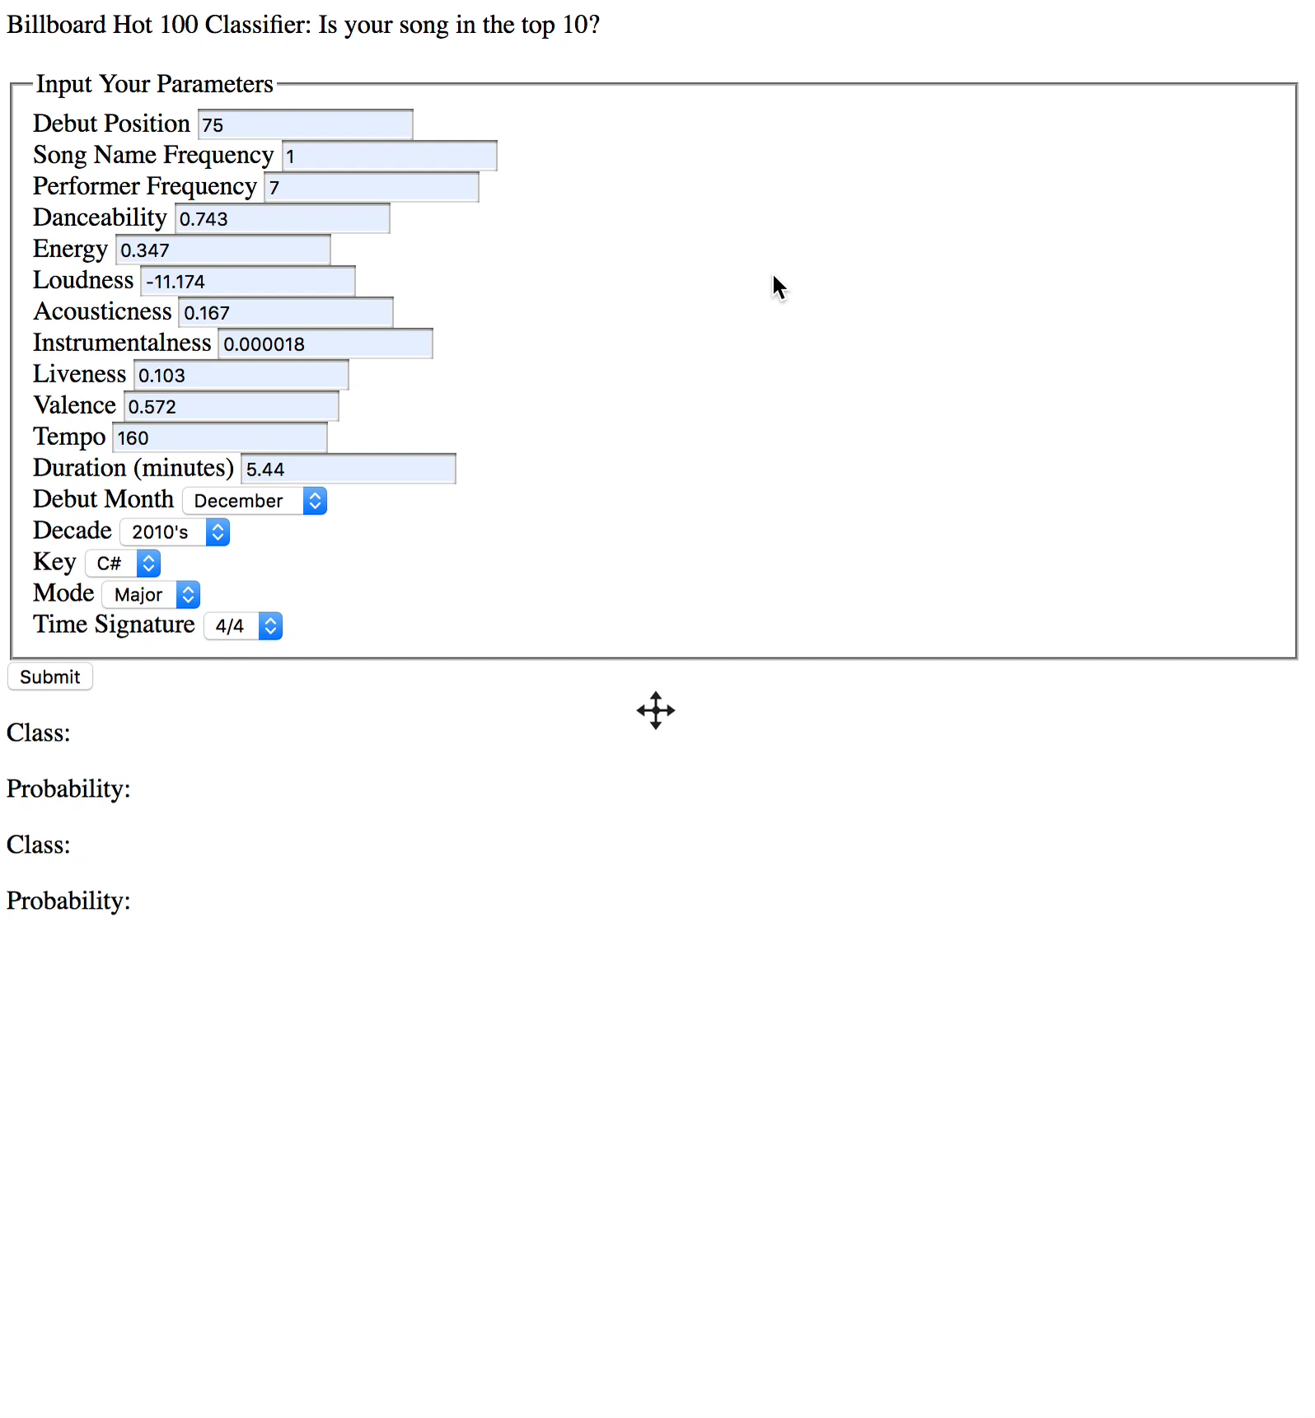
Notes:
Danceability has standard deviation of 0.15, so increasing danceability from 0.5 to 0.65 will give you 80% increased chance of getting a top 10 song.

Slide 18
future work
Add more features to data set
Artist genre
Artist’s record label
Number of appearances on Spotify playlists
Narrow down data to 2000’s songs

Slide 19
questions?

Slide 20
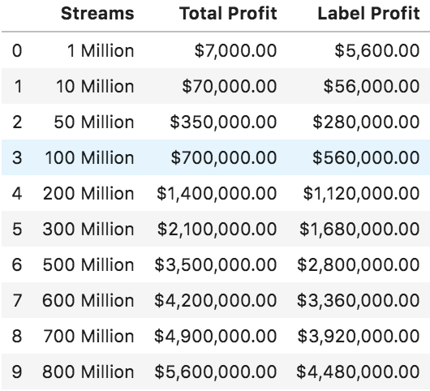
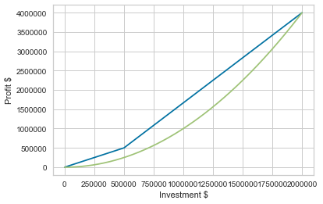
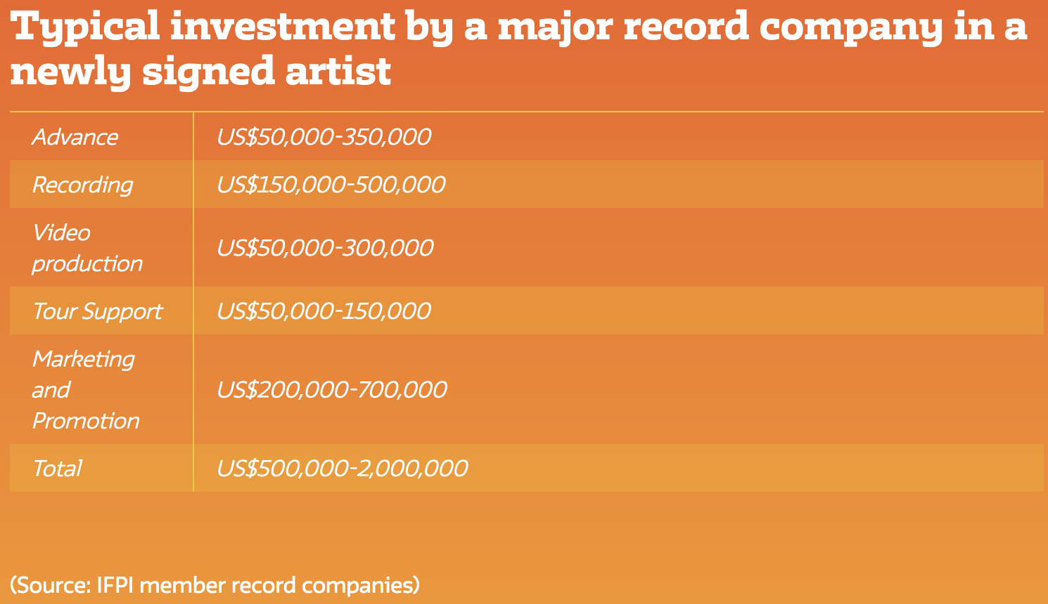
appendix

Slide 21
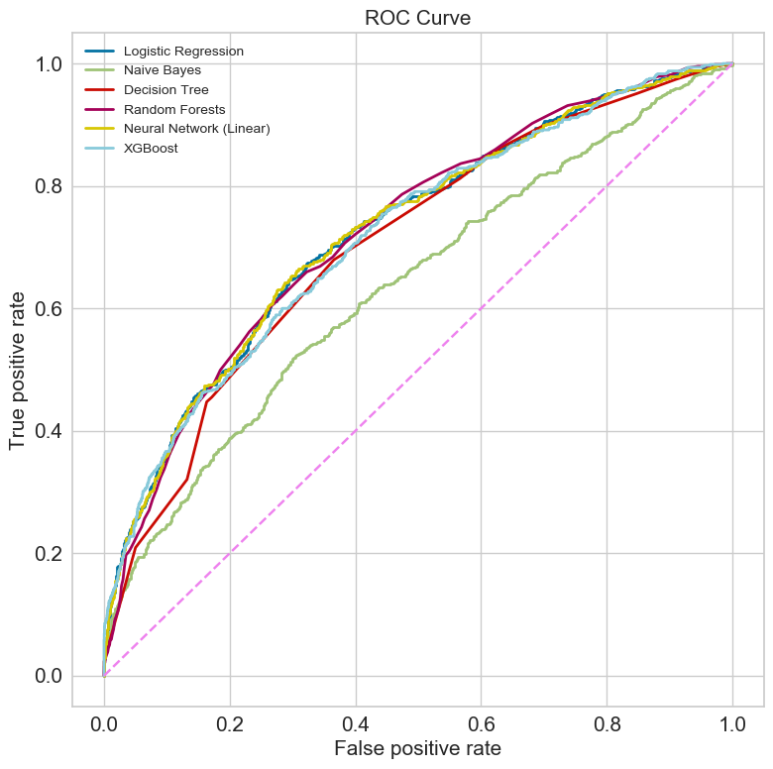
appendix

